Slide 1

Google Wave
Andres Ferrate
Developer Relations
Joe Gregorio
Developer Relations
Dan Peterson
Product Manager

Slide 2
Gadgets
  Go go gadget gadget!

Slide 3
Gadgets
- HTML + JS wrapped in XML
- ~ OpenSocial/iGoogle
-

Slide 4
Example
<?xml version="1.0" encoding="UTF-8" ?>
<Module>
<ModulePrefs title="Hello Wave">
<Require feature="wave" />
</ModulePrefs>
<Content type="html">
<![CDATA[
Hello, Wave!
]]>
</Content>
</Module>

Slide 5
Serving a Gadget file
application: jcgbot
version: 1
runtime: python
api_version: 1
handlers:
- url: /_wave/.*
script: robot.py
- url: /static/(.*)
static_files: static/\1
upload: static/(.*)

Slide 6
Serving a Gadget file
- Create 'static' directory
- Create static/gadget.xml
- Upload App
- Test:
http://<appid>.appspot.com/static/gadget.xml
- Solution: tutorial6

Slide 7
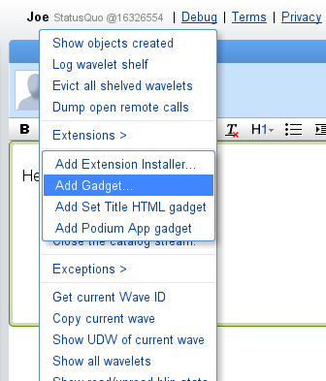
Adding the gadget manually

Slide 8
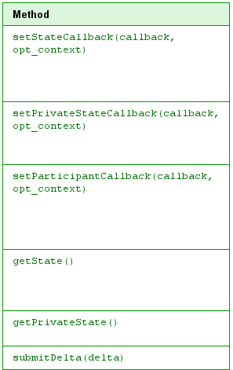
Gadget capabilities

Slide 9
Gadget Debugging Tips
- Chrome Developer Tools
- wave.log(“Foo”)
http://code.google.com/apis/wave/extensions/gadgets/guide.html#debug

Slide 10
Exercise
- Create the gadget equivalent of
the last exercise
- When the user presses “+” also
set the state for the gadget.
- Solution: tutorial7
- Start with gadget.xml
- Solution in gadget-final.xml

Slide 11
Gadgets and Robots
  Wonder twin powers activate

Slide 12
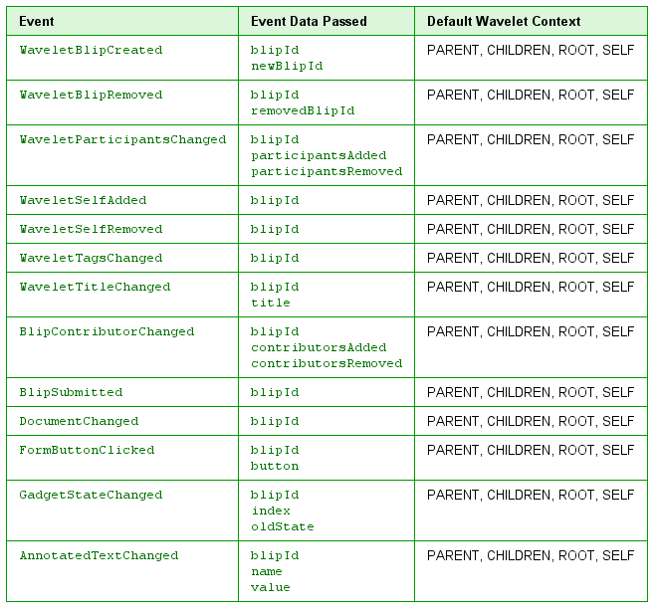
Events

Slide 13
Exercise
- Start with the last exercise
- Create a robot that adds the gadget
- Have the robot comment when
the gadget state changes
- Solution: tutorial8

Slide 14
Thank You
  Questions?

